Slide 1
CS 547
Week 3 Day 2
PHP & MySQL

Slide 2
Agenda
MySQL
Assignment 1

Slide 3
Review
From previous lecture

Slide 4
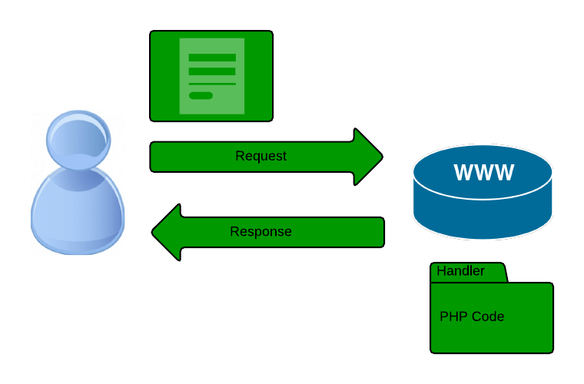
Recall

Slide 5
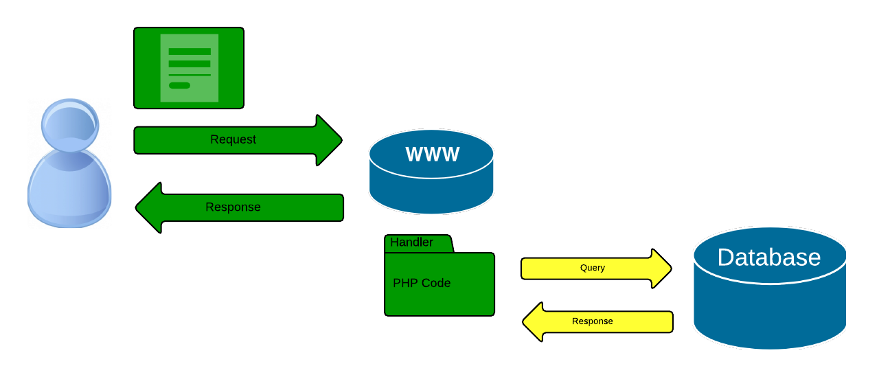
Dynamic Web Sites
Introduce a new ‘layer’ to the picture
Notes:
Recall from last lecture….

Slide 6
Dynamic Web Sites
We will focus on the php – database part
Notes:
Recall from last lecture….

Slide 7
PHP MySQL
Two correct ways for connecting to database
MySQLi – mysq
PDO – php Data Objects

Slide 8
PHP MySQL
One old – Deprecated way
mysql_* api

Slide 9
Which api to use?
MySQLi
Simpler syntax
Richer API
PDO
Faster
Supports other Databases
Object Oriented

Slide 10
MySQLi example
<?php
$DBServer = 'localhost'; // e.g 'localhost' or '192.168.1.100'
$DBUser = 'root';
$DBPass = '';
$DBName = 'test547';
$

Slide 11
MySQLi example
$conn = new mysqli($DBServer, $DBUser, $DBPass, $DBName);
// check connection
if ($conn->connect_error) {
trigger_error('Database connection failed: ' . $conn->connect_error, E_USER_ERROR);
}
else {
echo ("Connection Success.");

Slide 12
MySQLi example
echo ("Connection Success.");
$sql='SELECT * FROM mytable '; // $sql='SELECT * FROM mytable WHERE condition';
$rs=$conn->query($sql);
/* if($rs === false) {
trigger_error('Wrong SQL: ' . $sql . ' Error: ' . $conn->error, E_USER_ERROR);
} else {
$rows_returned = $rs->num_rows;
echo ("Found " + $rows_returned + " rows.");
$rs->data_seek(0);
while($row = $rs->fetch_row()){
echo $row[0] . '<br>';
}
}

Slide 13
MySQLi example
<?php
$DBServer = 'localhost'; // e.g 'localhost' or '192.168.1.100'
$DBUser = 'root';
$DBPass = '';
$DBName = 'test547';
$conn = new mysqli($DBServer, $DBUser, $DBPass, $DBName);
// check connection
if ($conn->connect_error) {
trigger_error('Database connection failed: ' . $conn->connect_error, E_USER_ERROR);
}
else {
echo ("Connection Success.");
$sql='SELECT * FROM mytable '; // $sql='SELECT * FROM mytable WHERE condition';
$rs=$conn->query($sql);
/* if($rs === false) {
trigger_error('Wrong SQL: ' . $sql . ' Error: ' . $conn->error, E_USER_ERROR);
} else {
$rows_returned = $rs->num_rows;
echo ("Found " + $rows_returned + " rows.");
$rs->data_seek(0);
while($row = $rs->fetch_row()){
echo $row[0] . '<br>';
}
}
*/
if($rs === false) {
trigger_error('Wrong SQL: ' . $sql . ' Error: ' . $conn->error, E_USER_ERROR);
} else {
$rs->data_seek(0);
while($row = $rs->fetch_assoc()){
echo ("Name = " . $row['name'] . " age = " . $row['realAge'] . "<br>" );
var_dump($row);
}
}
}
?>

Slide 14
MySQLi example
<?php
$DBServer = 'localhost'; // e.g 'localhost' or '192.168.1.100'
$DBUser = 'root';
$DBPass = '';
$DBName = 'test547';
$conn = new mysqli($DBServer, $DBUser, $DBPass, $DBName);
// check connection
if ($conn->connect_error) {
trigger_error('Database connection failed: ' . $conn->connect_error, E_USER_ERROR);
}
else {
echo ("Connection Success.");
$sql='SELECT * FROM mytable '; // $sql='SELECT * FROM mytable WHERE condition';
$rs=$conn->query($sql);
/* if($rs === false) {
trigger_error('Wrong SQL: ' . $sql . ' Error: ' . $conn->error, E_USER_ERROR);
} else {
$rows_returned = $rs->num_rows;
echo ("Found " + $rows_returned + " rows.");
$rs->data_seek(0);
while($row = $rs->fetch_row()){
echo $row[0] . '<br>';
}
}
*/
if($rs === false) {
trigger_error('Wrong SQL: ' . $sql . ' Error: ' . $conn->error, E_USER_ERROR);
} else {
$rs->data_seek(0);
while($row = $rs->fetch_assoc()){
echo ("Name = " . $row['name'] . " age = " . $row['realAge'] . "<br>" );
var_dump($row);
}
}
}
?>

Slide 15
MySQLi examples
Iterate over recordset
Using MYSQLI_ASSOC an associated array is returned, MYSQLI_NUM an enumerated one and MYSQLI_BOTH both of them.
WARNING: fetch_all is available only with MySQL Native Driver.

Slide 16
More sql commands
Record count
$rows_returned = $rs->num_rows;
Move inside recordset
$rs->data_seek(10);
Free memory
Optional:
$rs->free();

Slide 17
SQL Insert Command
$v1="'" . $conn->real_escape_string('col1_value') . "'";
$sql="INSERT INTO mytable (name_varchar, age_number) VALUES ($v1,10)";
if($conn->query($sql) === false) {
trigger_error('Wrong SQL: ' . $sql . ' Error: ' . $conn->error, E_USER_ERROR);
} else {
$last_inserted_id = $conn->insert_id;
$affected_rows = $conn->affected_rows;
}

Slide 18
SQL UpDate
$v1="'" . $conn->real_escape_string('col1_value') . "'";
$sql="UPDATE mytable SET name_varchar=$v1, age_number=21 WHERE id>10";
if($conn->query($sql) === false) {
trigger_error('Wrong SQL: ' . $sql . ' Error: ' . $conn->error, E_USER_ERROR);
} else {
$affected_rows = $conn->affected_rows;
}

Slide 19
SQL Delete
$sql="DELETE FROM mytable WHERE id>10";
if($conn->query($sql) === false) {
trigger_error('Wrong SQL: ' . $sql . ' Error: ' . $conn->error, E_USER_ERROR);
} else {
$affected_rows = $conn->affected_rows;
}

Slide 20
SQL Pattern
The commands we just covered follow a common pattern: CRUD
C == Create a record
R == Read one or more records
U == UpDate one or more records
D == Delete a records
This CRUD pattern is at the heart of modern dynamic websites.

Slide 21
File Layout
To facilitate your web development it is recommended that you organize your files in some particular way. There are two choices
Hierarchically
One Big Mess

Slide 22
PHP External Files
PHP has four ways for incorporating external files
include();
include_once();
require();
require_once();

Slide 23
Include VS Require
When successful, both give same behavior; however, they have different behavior on error.
Function | Successful | Fails
include(); | Same | warning - continue
include_once(); | Same | warning - continue
require(); | Same | Error printed - halt
require_once() | Same | Error printed - halt

Slide 24
Paths Matter
There are two types of paths
Absolute – Start at the top of the file system C:\xamp\htdoc\
Relative – Start at the file localtion in the file system
include(‘../ex2/file_proc.php’);

Slide 25
File extension also matter
Remember that files with a *.html extension are sent to the browser without any (if any checking).
Files with a *.php are preprocessed by PHP before being sent to the browser.
It is recommended that you use
*.inc.php for files that include sensitive information
*.inc.html for files that do not include sensitive information

Slide 26
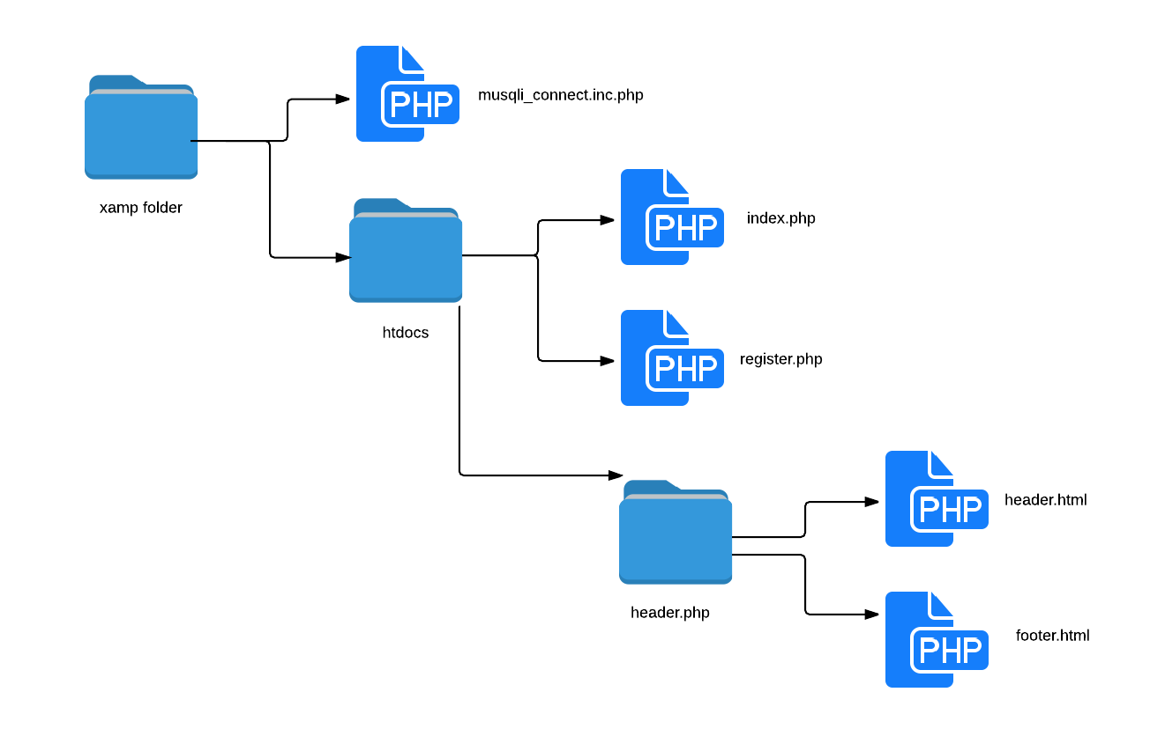
Website Layout

Slide 27
First Assignment
The first assignment is posted on BlackBoard we will go over it now
Due April 6th 2015 at 5:30 pm PST

